Slide 1
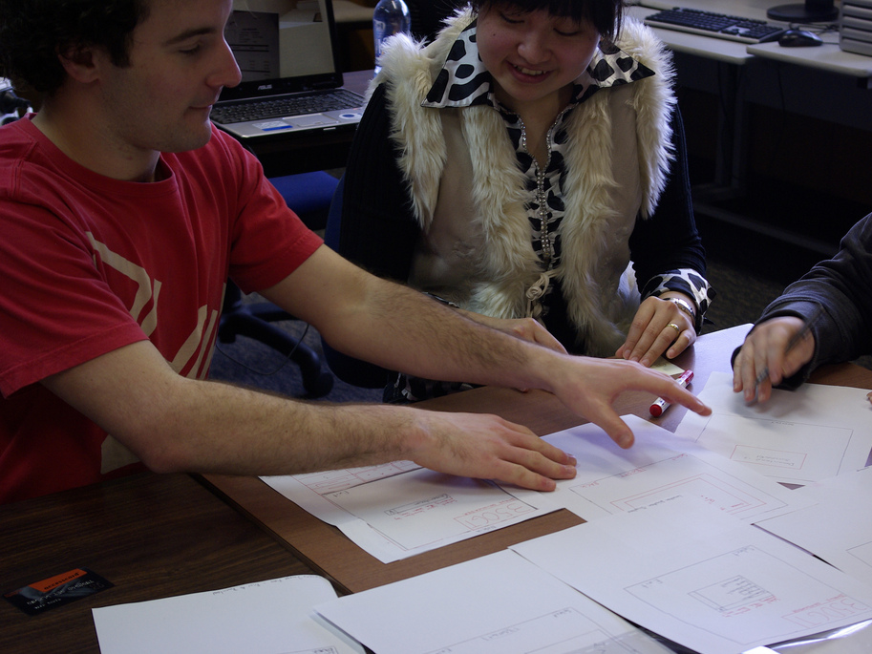
Paper Prototyping
http://www.flickr.com/photos/21218849@N03/3901372331/sizes/l/

Slide 2
Customers and users should be your friends
They probably know much more about the problem than you do.
They probably have some ideas about how to solve the problem.
They are your best resource for discovering your own mistakes before you start to code.

Slide 3
Risk: an unwanted event that has negative consequences
Risk impact: the loss that would result if a risk turns into a problem
Measured in time, quality, cost
Risk likelihood: probability that the risk will turn into a problem
Risk exposure = impact * likelihood
Risk control: the degree to which you can reduce exposure

Slide 4
Risk management
Risk management
Risk assessment
Risk identification
Risk analysis
Risk prioritization
Risk control
Risk reduction
Risk management planning
Risk resolution

Slide 5
Example risks in an e-commerce application
Risk: mobile phones (unexpectedly) need to be supported
Impact: 30% of revenue? Likelihood: ???
Risk: credit card validation component cannot handle debit cards
Impact: 10% of revenue? Likelihood: ???

Slide 6
Risk management and prototyping
Traditional requirements-gathering
Good for controlling risks regarding what the system should do
But don’t know what the system should look like
Prototyping
Good for controlling risks regarding what the system should look like
Not so good for non-interaction aspects of the system

Slide 7
Top ten risks
Personnel shortfalls
Unrealistic schedules and budgets
Developing the wrong software functions
Developing the wrong user interface
Gold plating
Continuing stream of requirements changes
Shortfalls in externally performed tasks
Shortfalls in externally furnished components
Real-time performance shortfalls
Straining computer science capabilities

Slide 8
Top ten risks
Personnel shortfalls
Unrealistic schedules and budgets
Developing the wrong software functions
Developing the wrong user interface
Gold plating
Continuing stream of requirements changes
Shortfalls in externally performed tasks
Shortfalls in externally furnished components
Real-time performance shortfalls
Straining computer science capabilities

Slide 9
The general idea of prototyping
You depict what you think the system should look like.
You test the prototypes with customers or (preferably) users.
You fix up the prototypes and use what you learn to implement the real system.

Slide 10
Rapid Prototyping / Waterfall
Rapid Prototype
Requirements
Design
Implementation
Testing
Deployment
Characteristics: Use a prototype built and discarded to inform requirements and design specification

Slide 11
Spiral kinds of processes
Draft a menu of program designs
Analyze risk & prototype
Draft a menu of architecture designs
Analyze risk & prototype
Draft a menu of requirements
Analyze risk & prototype
Establish requirements
Plan
Establish architecture
Plan
Operation
Testing
Implementation
Establish program design
Notes:
So, what are prototypes?

Slide 12
Different kinds of prototypes
Throwaway prototypes
Paper prototypes: sketches on pieces of paper
Low-fidelity prototypes: implemented with a tool (e.g.: Photoshop)
Evolutionary prototypes
High-fidelity prototypes: implemented on the target platform… not fully functional, but destined to be incorporated into the final product

Slide 13
Paper prototypes
Sketch on paper and/or post-it notes
Don’t worry (much) about colors, fonts, icons
Doesn’t need to be beautiful
Does need to show all important UI elements
Does need to be intelligible by users

Slide 14
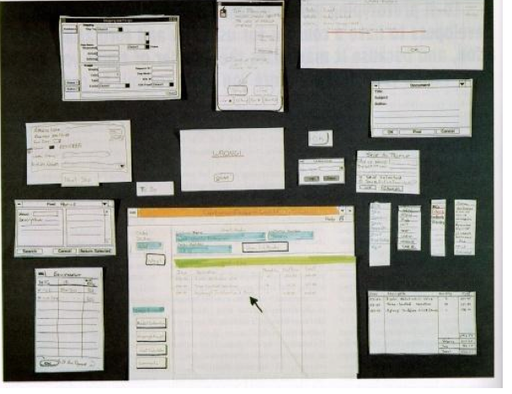

Slide 15
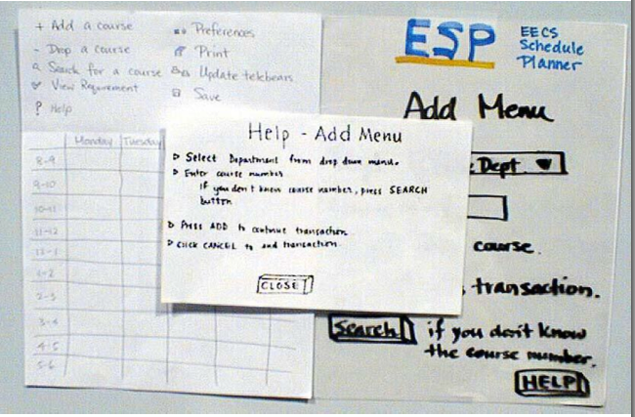

Slide 16
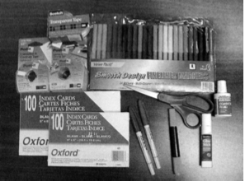
Tools for prototyping
White poster board (11”x14”)
For background, window frame
Big (unlined) index cards
For menus, window contents, dialog boxes
White correction tape
For text fields, checkboxes, short messages
Overhead transparencies
For highlighting, user “typing”
Photocopier
For making multiple blanks
Pens & markers, scissors, tape

Slide 17
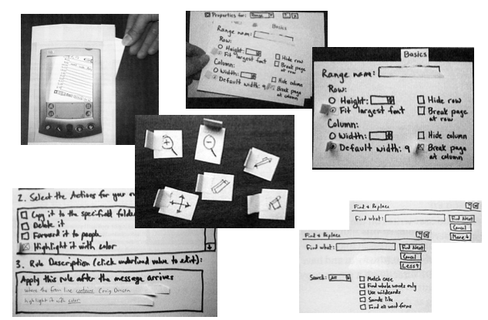
Interface Elements

Slide 18
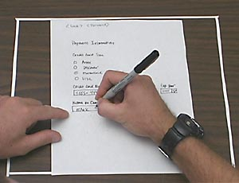
Provide users with interactive paper mockup
Entering text in a lo-fi paper mockup

Slide 19
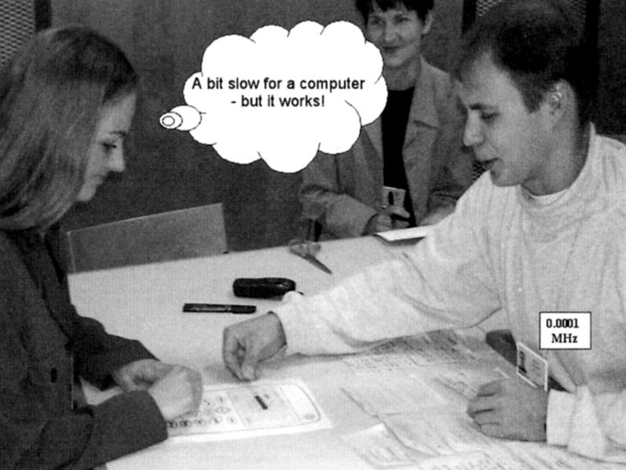
Paper prototype testing
observer
user
computer
Interface
Interface elements

Slide 20
Paper prototype usability testing
Facilitator
Gives instructions
Encourages user to speak
Computer
simulates response of system
Observers
Take notes
HW2: Due: Sat: 10/24
You will perform a paper prototype test with your client
In class paper prototype testing – 10/22

Slide 21
UC#1: Report panhandler
Actor: any user
Preconditions: user views site in mobile browser
Postconditions: system records report
Flow of events:
User selects a city
User enters information about the panhandler
System validates inputs
System records report in database

Slide 22
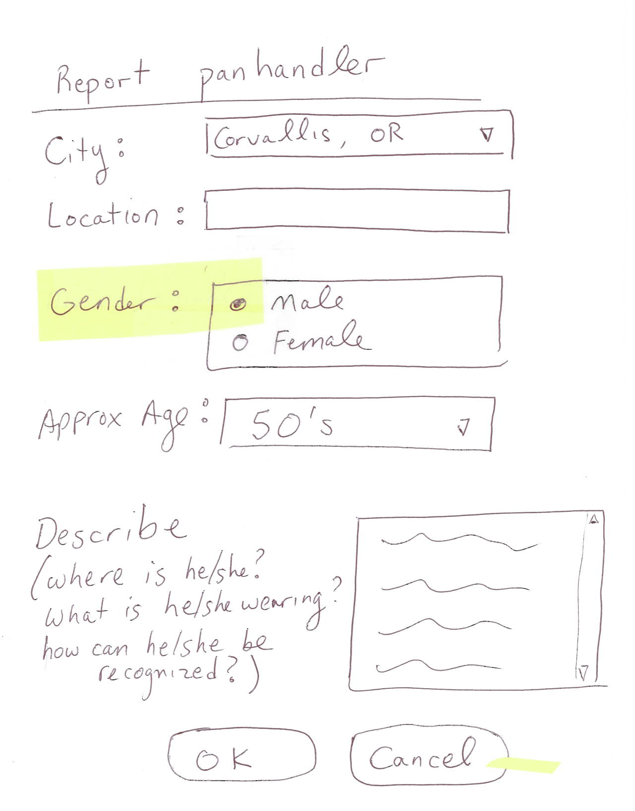
User selects a city
User enters information about the panhandler
System validates inputs
System records report in database

Slide 23
UC#2: Process panhandler
Actor: volunteer (member of task force)
Preconditions: volunteer logged in via mobile browser
Postcondition: system logs report as done
Flow of events:
Volunteer reviews list or map of panhandlers
Volunteer marks report as “claimed”
System records report as claimed
Volunteer visits the panhandler
Volunteer marks report as “done”
System records report as done

Slide 24
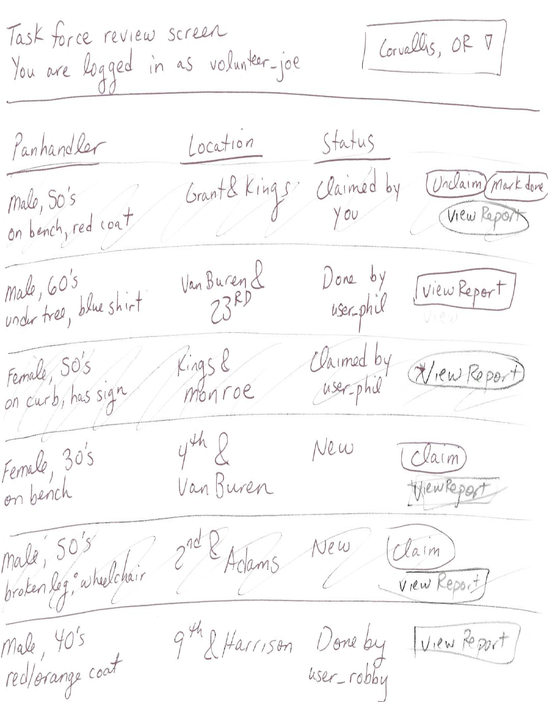
Volunteer reviews list or map of panhandlers
Volunteer marks report as “claimed”
System records report as claimed
Volunteer visits the panhandler
Volunteer marks report as “done”
System records report as done

Slide 25
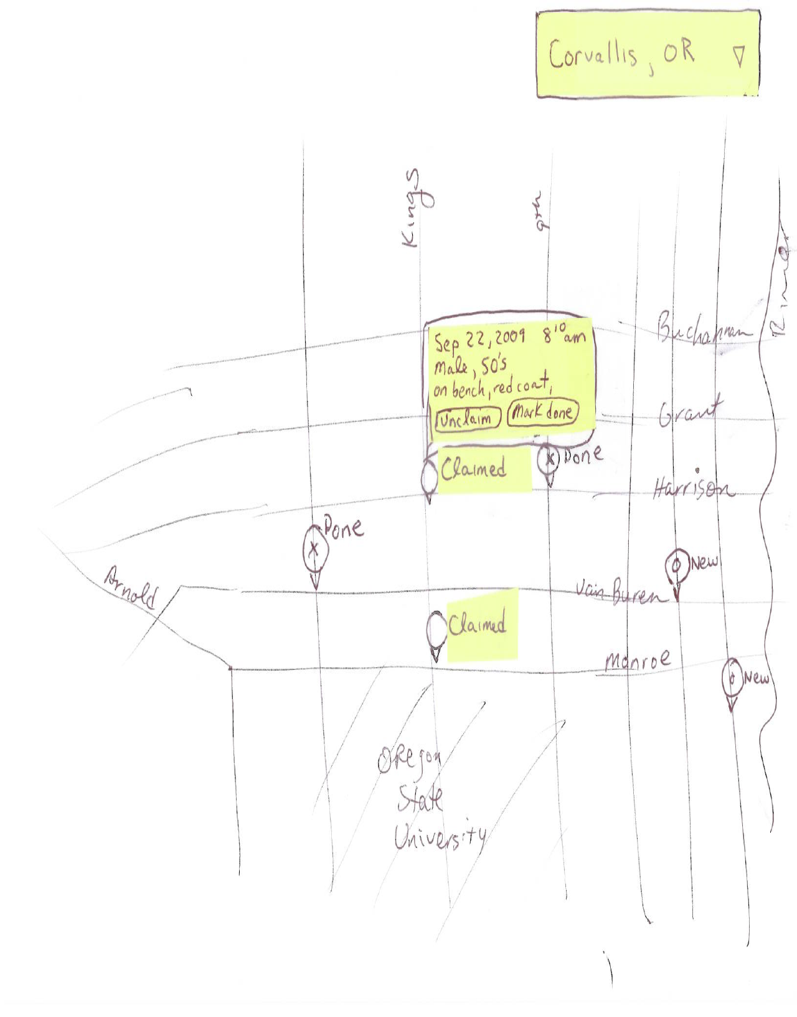
Volunteer reviews list or map of panhandlers
Volunteer marks report as “claimed”
System records report as claimed
Volunteer visits the panhandler
Volunteer marks report as “done”
System records report as done

Slide 26
Some problems revealed by prototype
What happens during “validation” of a panhandler report?
How does the volunteer navigate from the “list view” to the “map view”?
What happens if there are lots and lots of reports… how does the user make sense of it?
So what happens when the user marks a panhandler report as “done”?

Slide 27
Non-visual problems that the prototype might not catch
What if there are duplicate reports?
How do new cities get added to the system?
Do users need to be authenticated to make a panhandler report? Why/why not?
Is the mapping interface really going to run properly in a mobile browser? Sounds risky.
Identifying such problems requires techniques beyond prototyping.

Slide 28
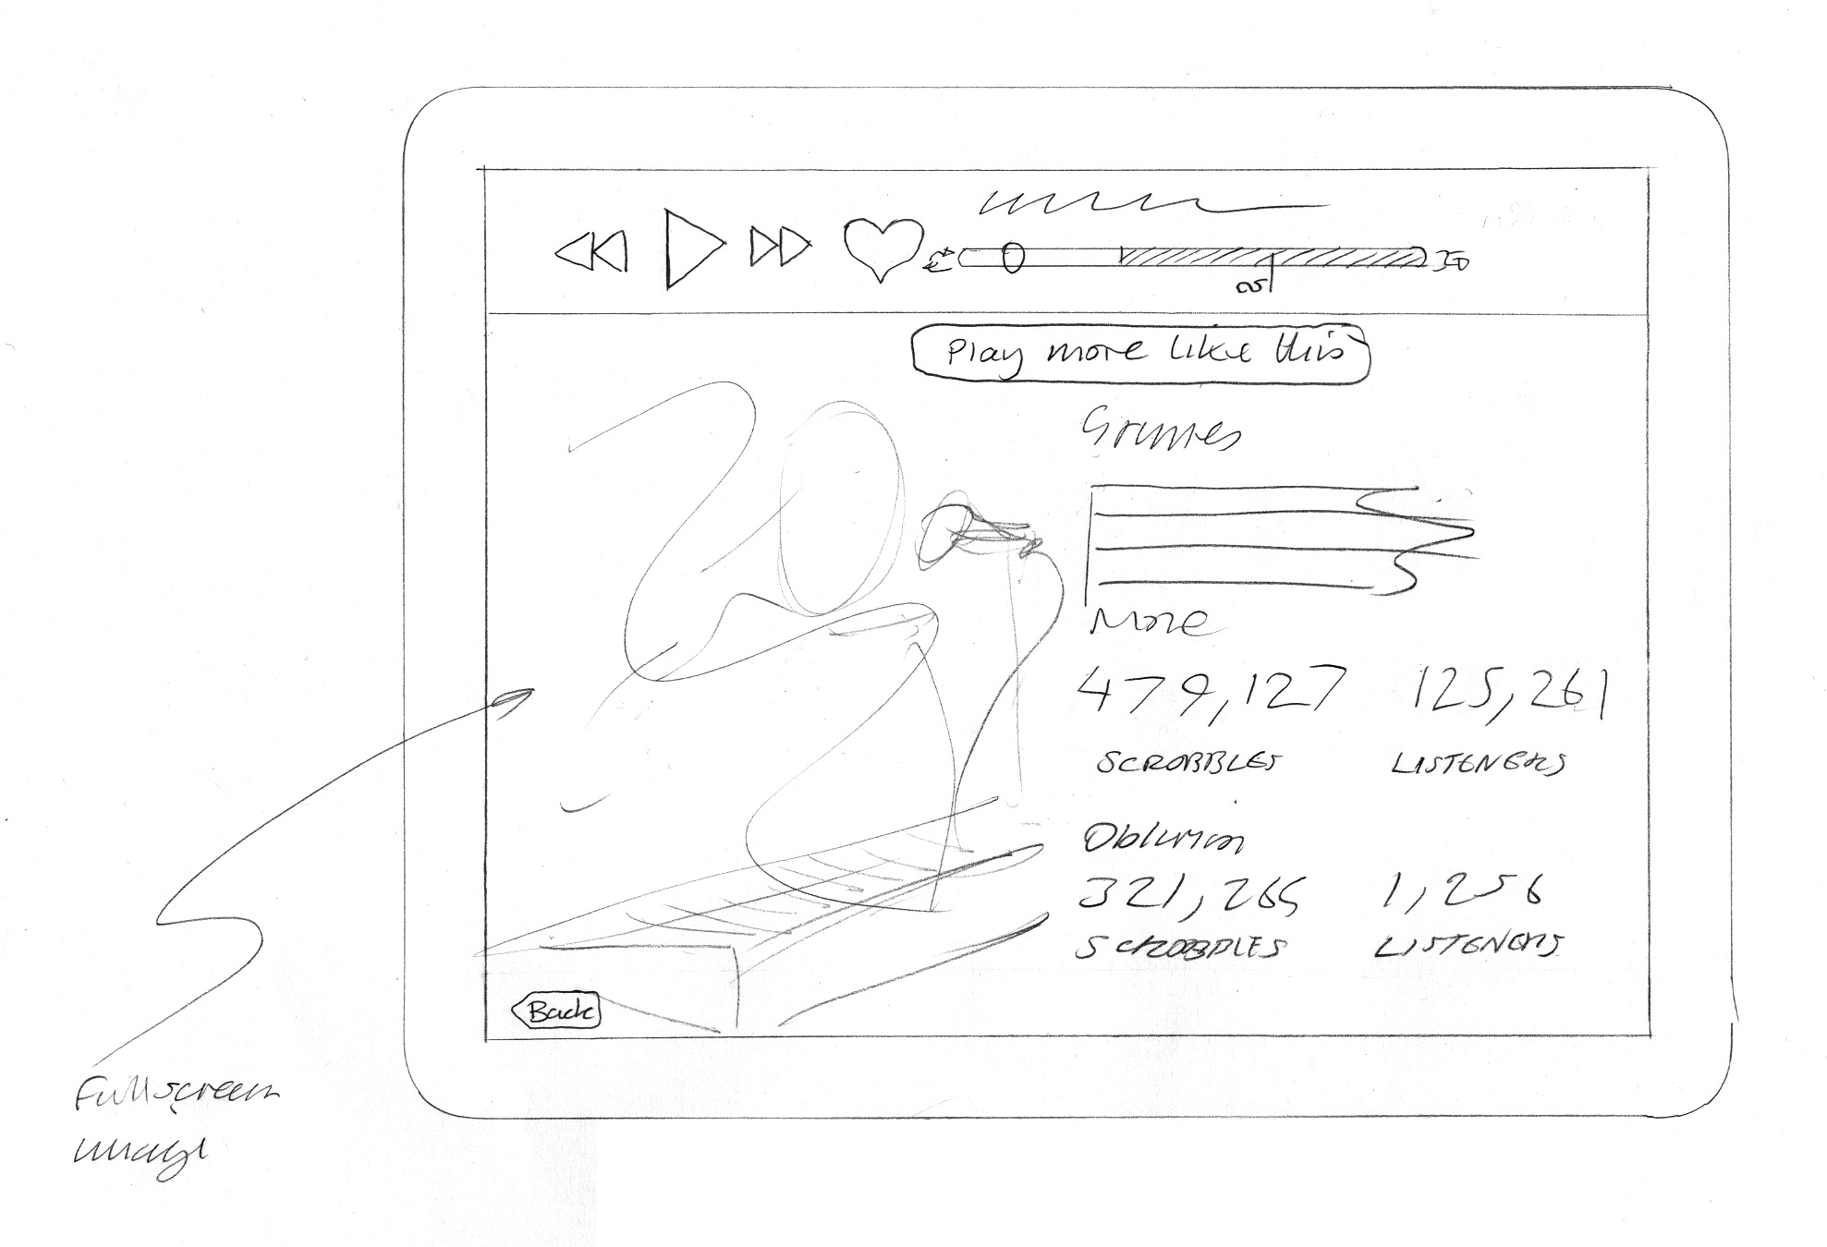
Another example of a paper prototype
http://grahamtodman.co.uk/blog/wp-content/uploads/2012/05/play-mode-lastfm-ipad.jpg

Slide 29
Low-fidelity prototypes
Fidelity = “faithfulness” or closeness to what the ultimate product would look like
Paper prototypes are “ultra low” fidelity
Low-Hi fidelity prototypes can be made in
Photoshop
PowerPoint
HTML
Any other tool that’s cheap and easy to use

Slide 30
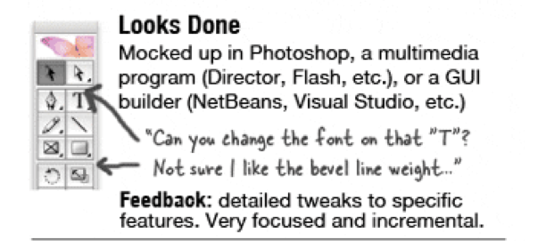
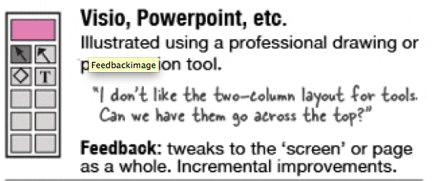
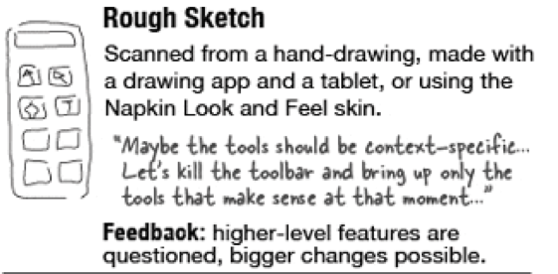

Slide 31
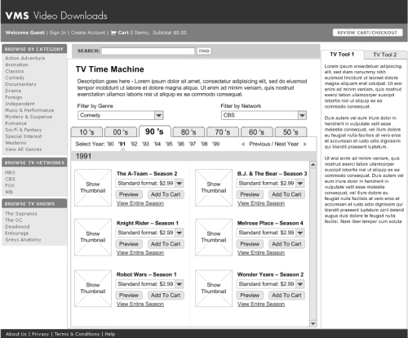
http://www.smashingmagazine.com/wp-content/uploads/2010/05/wireframe-500.jpg

Slide 32
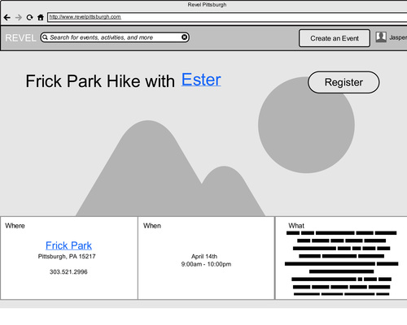
http://static.squarespace.com/static/52f41348e4b013e3f94028e0/538d1789e4b0f432bcf13816/538d178be4b0f432bcf1381b/1401755549583/Moqups%20Prototype-6.jpg?format=500w

Slide 33
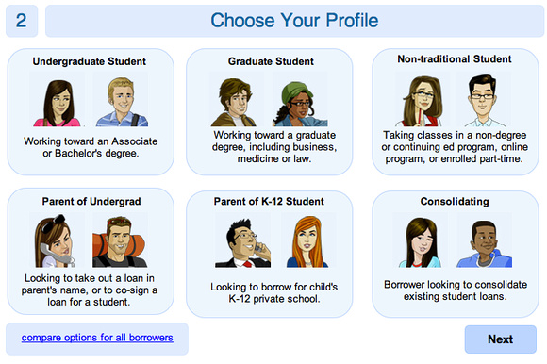
http://evakaniasty.zenfolio.com/img/s3/v44/p431499617-3.jpg

Slide 34
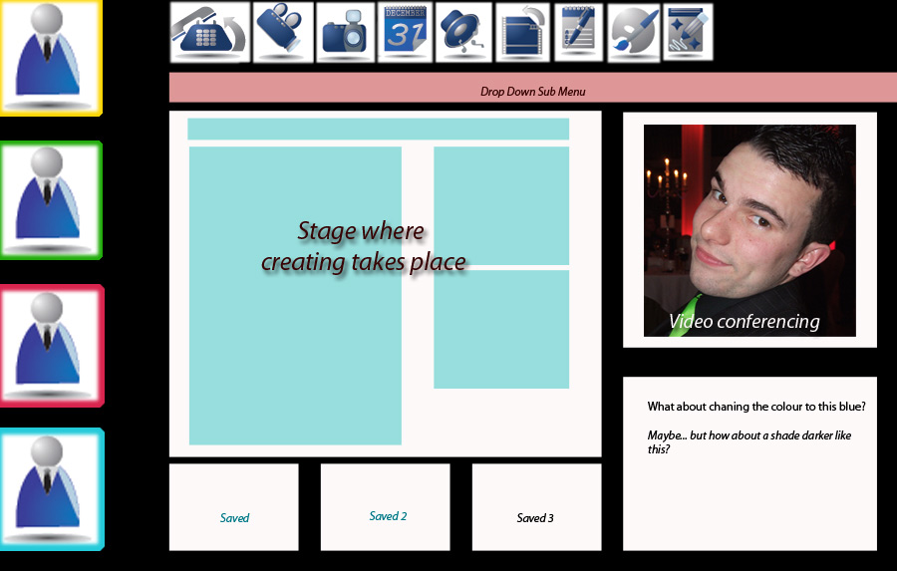
http://oflynnm.richie.idc.ul.ie/images/prototype.jpg

Slide 35
Paper vs. low-fidelity
Low-fidelity lets you explore
Colors, fonts, iconography, etc
But low-fidelity
Is more expensive
Requires somebody with design “skillz”
Is harder to fix on the fly
And neither one can detect certain problems…
…but low-fidelity is better than hi-fidelity (front UI built using technology)

Slide 36
What’s next for you
HW1 is due this Saturday
a few words on team management
Next Tuesday (10/13)
Peer Evaluation of vision statements
You will be paired up
Read statement before class
During class
evaluate the statement based on the 4 criteria
provide feedback to your peer

